Slide 1
Food Delivery Across Canada
BAX 421
Qinyi Qiu

Slide 2
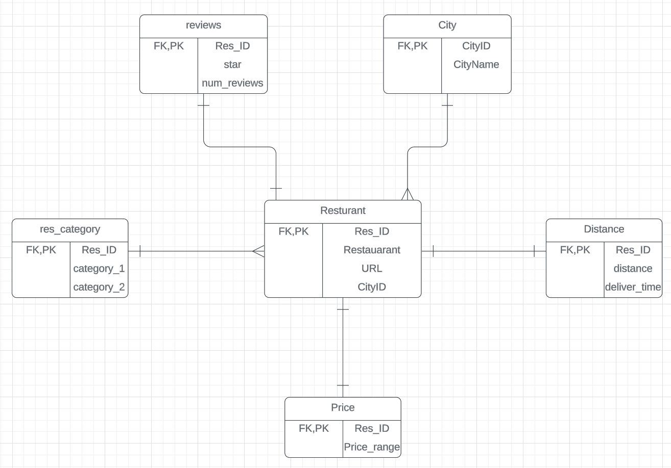
Data Info
The data shows restaurants with under 30 minutes delivery time using the iconic place address in downtown for 8 different populous cities in Canada.
Variables: restaurants’ name, number of reviews of each restaurants, delivery time, distance etc.
Separated the dataset into 6 tables: Restaurant, City, Price, Reviews, Restaurant category

Slide 3
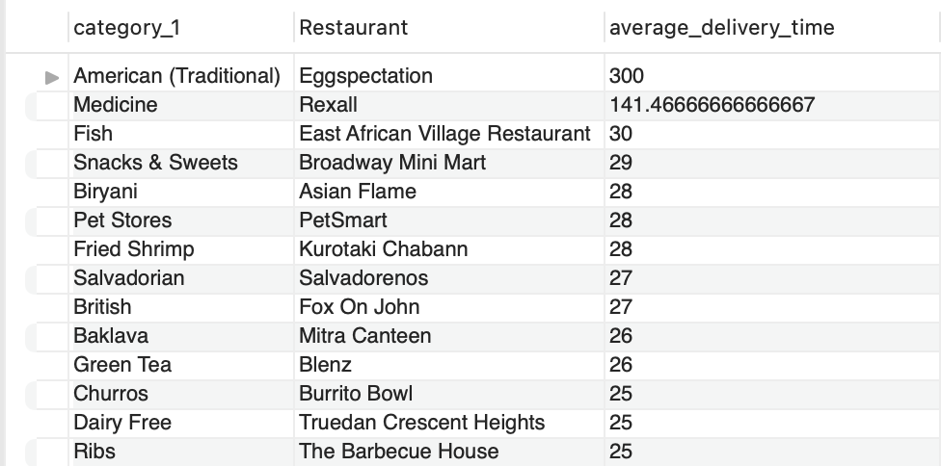
Question 1:
What is the name of the restaurant with the longest average delivery time, and what is that time, for each category of restaurant?
Insight: American (Traditional), have significant room for improvement in terms of delivery efficiency. For 'Eggspectation', addressing the cause of such a lengthy delivery time could greatly enhance their service offering.

Slide 4
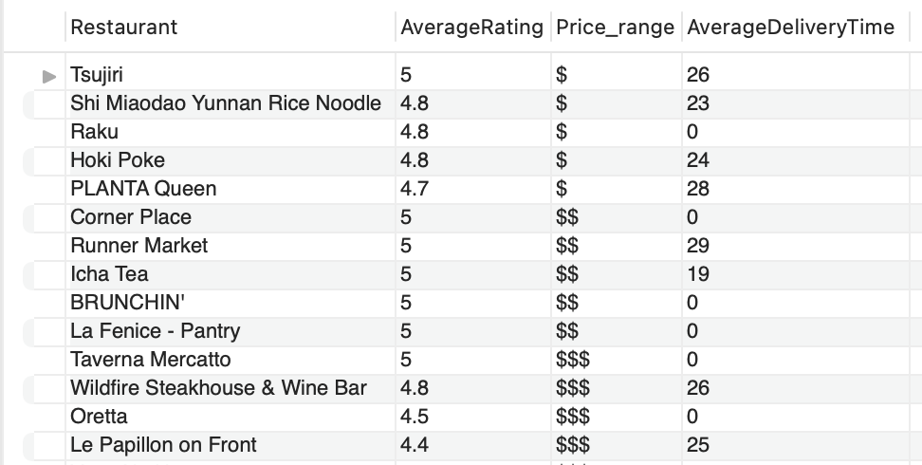
Question 2:
What are the top 5 restaurants with the highest average review star rating, within each price level, in Toronto? Additionally, for these top-rated restaurants, what is the average delivery time?

Slide 5
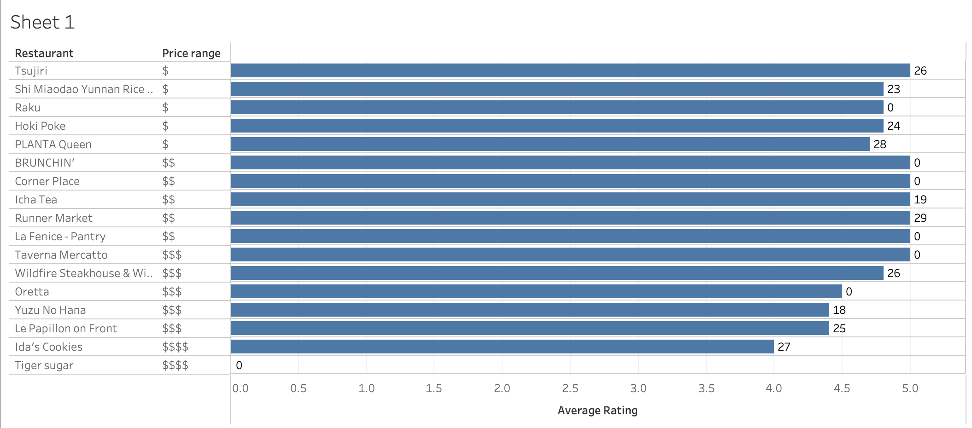
Bar chart
restaurants with higher ratings could be leveraged as key players in their respective price categories, potentially attracting more customers looking for quality experiences as indicated by star ratings.
some top-rated restaurants have optimized their delivery times well, others may not have.
Notes:
some top-rated restaurants have optimized their delivery times well, others may not have. Restaurants like 'Ida’s Cookies' and 'PLANTA Queen' demonstrate that it is possible to achieve a high average rating while also maintaining a swift delivery service.

Slide 6
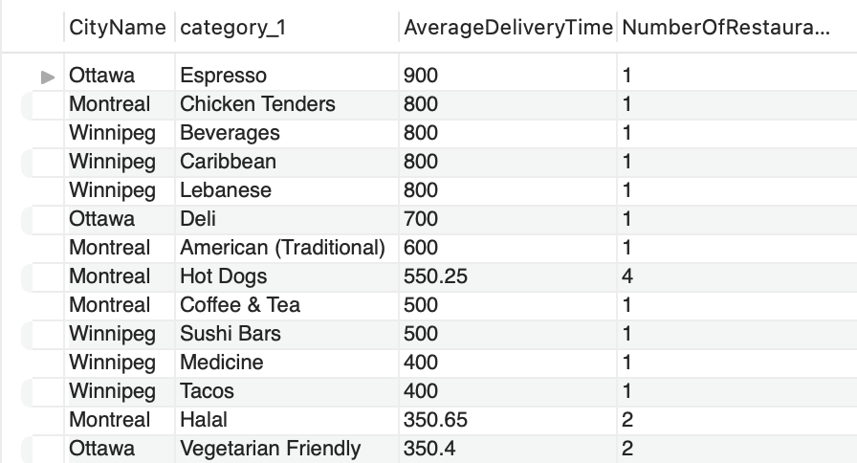
Question 3:
In which areas does a particular category of cuisine have low representation (number of restaurants). but high delivery demand, indicating a potential market for restaurant expansion or introducing new cuisines?
Insight: Espresso, Chicken Tenders may represent untapped market opportunities for new restaurant openings or expansion in these cities.
Notes:
The "Espresso" category in Ottawa, "Chicken Tenders" in Montreal, and "Beverages," "Caribbean," and "Lebanese" in Winnipeg all show high average delivery times but have only one restaurant representing each category in those cities. This suggests a high delivery demand for these types of cuisine, coupled with a low representation (number of restaurants). these categories may represent untapped market opportunities for new restaurant openings or expansion in these cities. The significant demand, as indicated by the high delivery times, implies that customers are waiting longer for these foods, which can be an indicator of insufficient supply to meet the current demand.

Slide 7
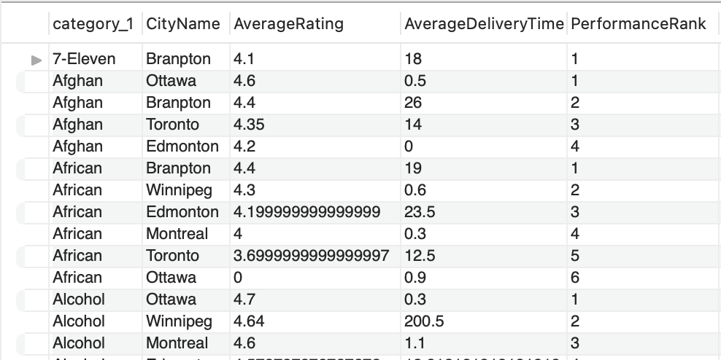
Question 4:
What are the performance of restaurants within different categories and cities?
The performance is evaluated based on the average star ratings and delivery times, and the results are ranked within each category.
Insight: the importance of not only maintaining high-quality ratings but also emphasizing efficient delivery services.

Slide 8
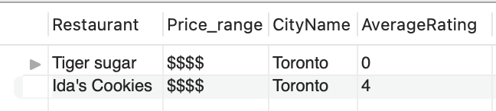
Question 5:
Which premium-priced restaurants (in the top price range) have lower than average review ratings?
Insight: not all high-priced restaurants are guaranteed high ratings, and factors other than price influence customer satisfaction

Slide 9
Question 6:
What is the difference in average delivery times between the top quartile and bottom quartile restaurants in terms of review stars?
top-rated restaurants deliver, on average, faster than those in the bottom quartile.
Insight: higher customer satisfaction in terms of review stars may correlate with faster delivery times. It implies that restaurants delivering more quickly could be receiving better reviews, possibly due to customers valuing speed of service.

Slide 10
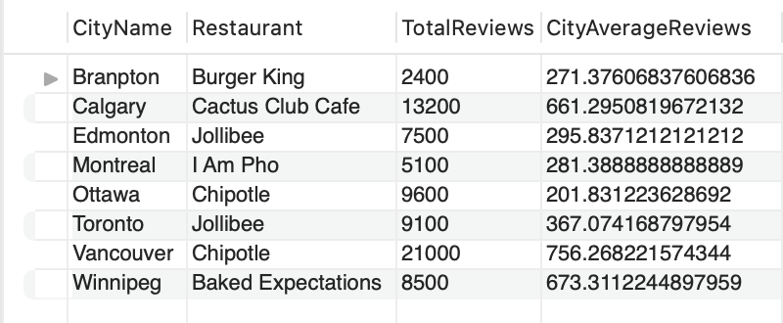
Question 7:
Which restaurant has the highest number of reviews, and how does this compare with the average number of reviews per restaurant in the same city?
find the restaurant with the highest number of reviews in each city and compare it with the city's average beside

Slide 11
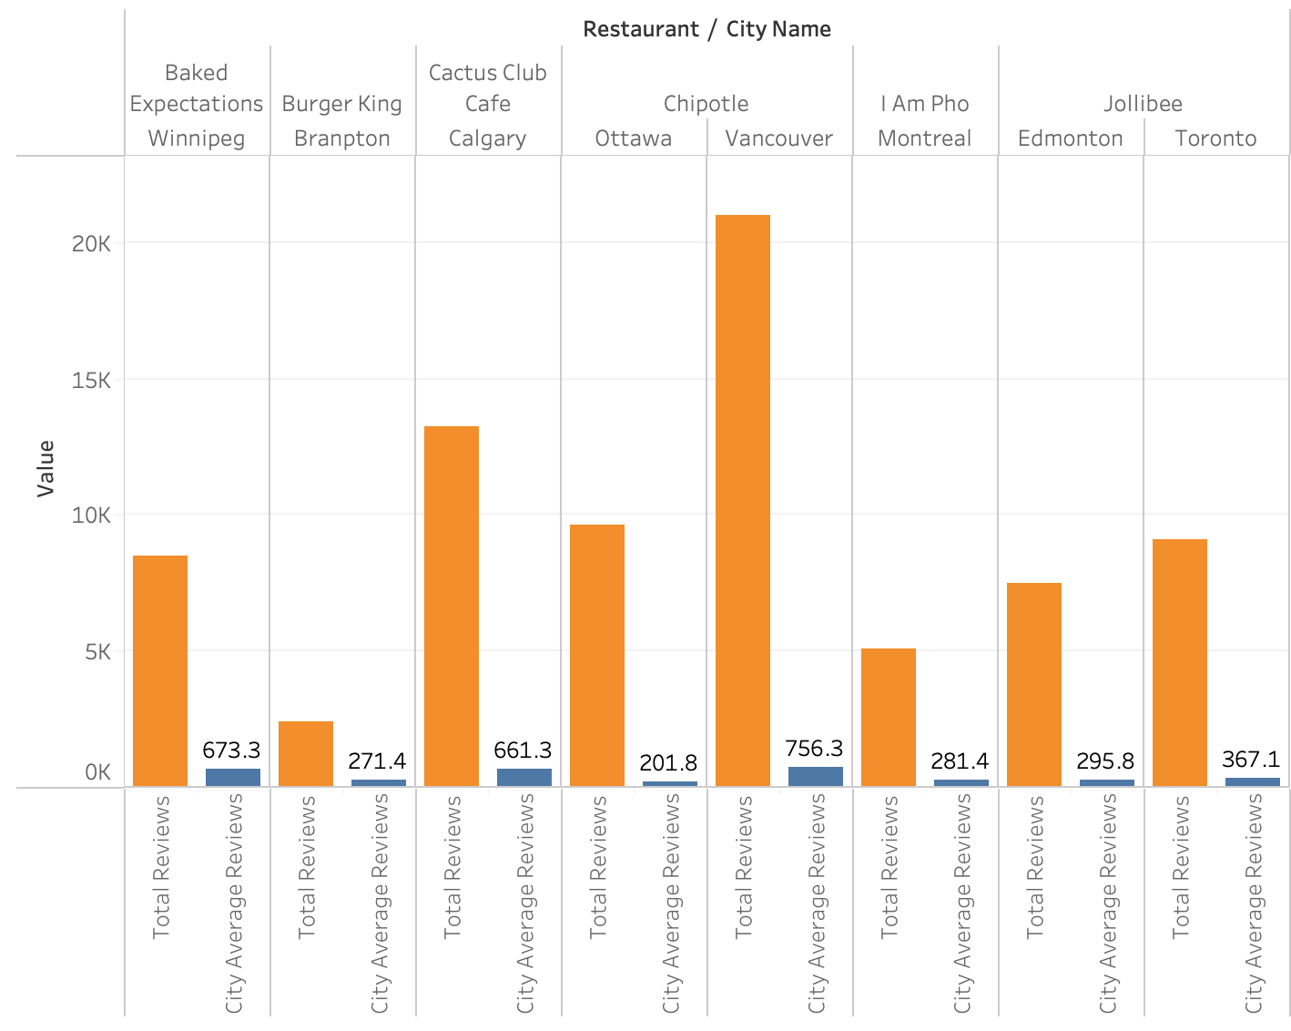
Bar chart
Insight: restaurants with a higher number of reviews may enjoy greater popularity, which could be due to various factors Businesses can look into these successful restaurants’ strategies to improve their own customer interaction and satisfaction.

Slide 12
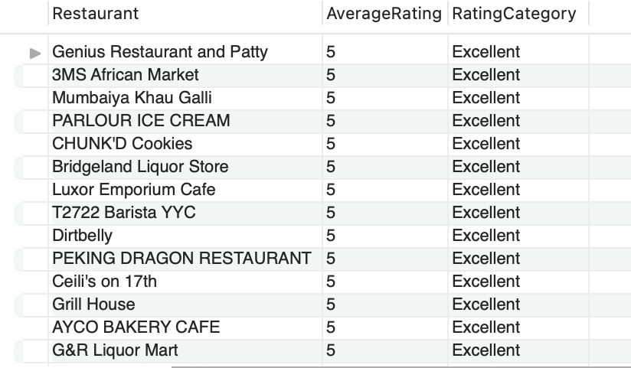
Question 8:
For each restaurant, what is the classification of its average star rating into categories such as 'Excellent', 'Good', 'Average', and ‘Poor’ based on percentile ranges?
Classification:
'Excellent' for an average rating of the first quantile.
'Good' for an average ratings of the second quantile
'Average' for ratings of the third quantile.
'Poor' for anything below fourth quantile.
Notes:
Use WITH clause creates a temporary result set (RankedRestaurants) that ranks restaurants based on their average rating using the NTILE function. use NTILE Function divides the dataset into four parts (quartiles). Finally use case statement to classify restaurants into 'Excellent', 'Good', 'Average', or 'Poor' based on their quartile ranking.

